Slide 1
WELCOME…
Notes:
This is what we have planned for you today........................

Slide 2
Notes:
Leyland Trucks has been building trucks in Britain, and Leyland since 1896. We have many generations of truck builders at this plant that provides us with a community of truck expertise.
Leyland and DAF entered common ownership once again when PACCAR bought both companies in 1996 and 1998.
Leyland is owned by PACCAR who has its headquarters in Seattle on the West coast of the USA, and is one of the largest producers of heavy and medium trucks in the world.
Produce Peterbilt, Kenworth and DAF brand of trucks at sites all across the globe – delivered over 162,000 trucks last year
In order to give you an idea of the magnitude of PACCAR’s global activities, let’s take a look at where production is located.
DAF trucks have their headquarters and main assembly plant in Eindhoven, supported by the production facility here at Leyland in the UK.

Slide 3
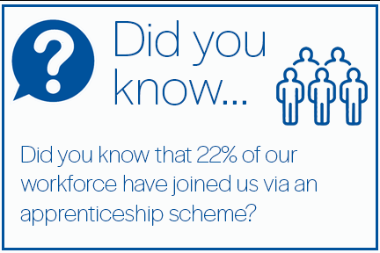
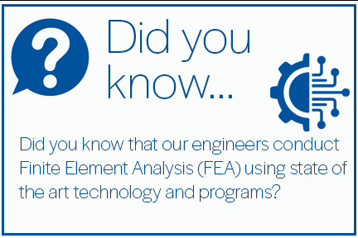
Notes:
Leyland Trucks has been building trucks in Britain, and Leyland since 1896. We have many generations of truck builders at this plant that provides us with a community of truck expertise.
Leyland and DAF entered common ownership once again when PACCAR bought both companies in 1996 and 1998.
Leyland is owned by PACCAR who has its headquarters in Seattle on the West coast of the USA, and is one of the largest producers of heavy and medium trucks in the world.
Produce Peterbilt, Kenworth and DAF brand of trucks at sites all across the globe – delivered over 162,000 trucks last year
In order to give you an idea of the magnitude of PACCAR’s global activities, let’s take a look at where production is located.
DAF trucks have their headquarters and main assembly plant in Eindhoven, supported by the production facility here at Leyland in the UK.

Slide 4
Our Scheme
Variety of approved Government Apprenticeship Schemes
Preston’s College, UCLan, Runshaw, Training 2000 & Leeds Trinity University
Regular communication with the college
Structured workplace rotations to ensure a wide-breadth of experience
Notes:
Follow Government approved Apprenticeship standards which mean that, not only do you complete a formal qualification, but you also have proof of your ability to do the job.
We use Preston’s College for the majority of our apprenticeships and for those that progress onto degrees we use UCLan. Training 2000, Runshaw and Leeds Trinity are also now being used as the scheme extends.
Attendance at the college varies depending on the apprenticeship that you are on.
We work very closely with the training providers to ensure that the scheme meets the needs of both the apprentice and the business and have the ability to tailor courses to our needs.
Some follow a very formal workplace rotation, whereas others are moved around at appropriate times, but the aim is that you all get to experience as much of the business as possible applicable to your role.

Slide 5
What happens after the apprenticeship?
Notes:
Aim is to secure a permanent position within the company
Track record of placing successfully completed apprentices
Continue development and growth within the business
Ex-apprentices are throughout our business and at all levels

Slide 6
2023 Intake (applications now closed)
Assembly Operatives x 12 3 years – Level 3
Automotive Engineers x 6 4 years – Level 4
Facilities & Maintenance x 2 4 years – Level 4
Supply Chain x 2 4 years – Level 6
Design Engineers x 2 5 years – Level 6

Slide 7
Intake Process
Applications open January 2024
Schools and Colleges are informed
Complete an Application Form
Interview (and practical test) take place in the Easter holidays
Start in September 2024

Slide 8
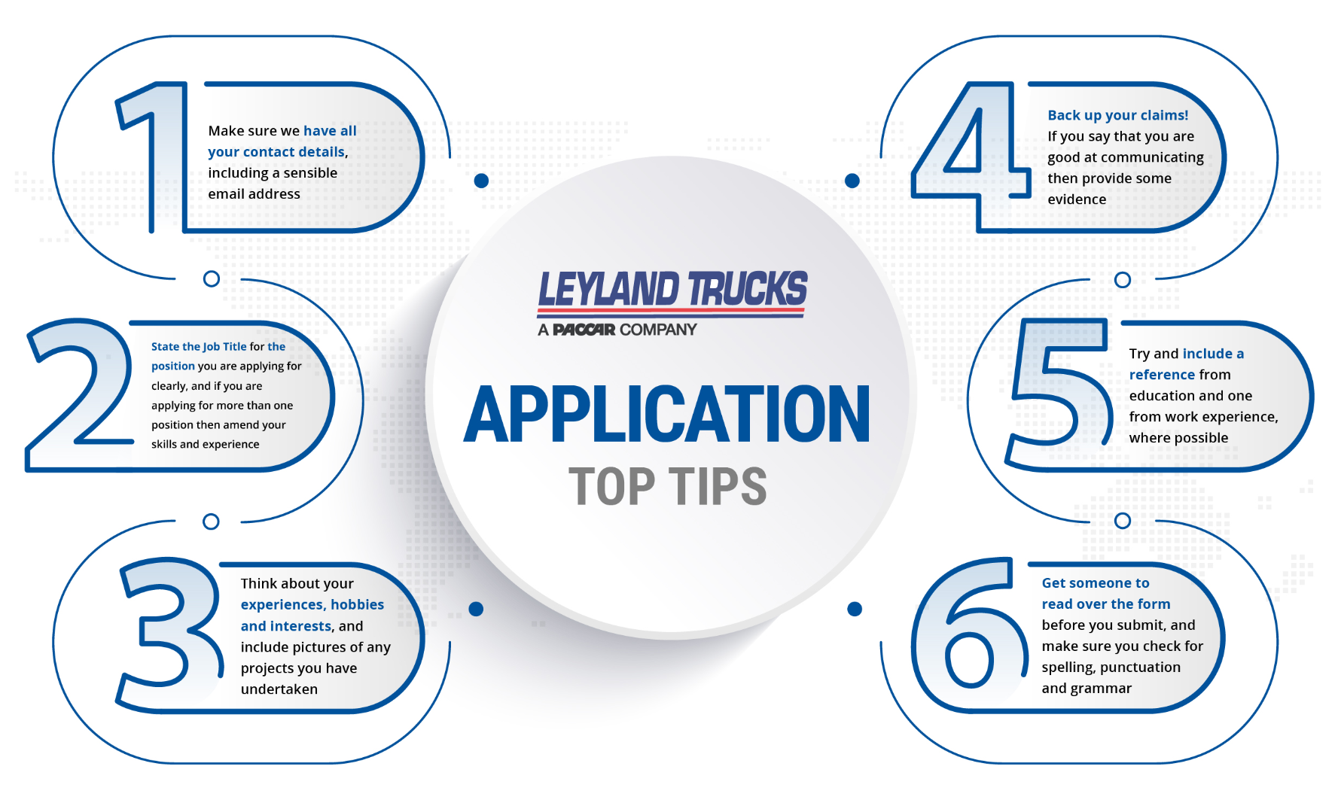
What are we looking for?
Good Grades (5 GCSE 9-4 incl Eng & Maths/Level 3 qual)
Reliable (prefect/team captain/responsibility)
Enthusiastic (wants to work in their chosen field)
Skills (evidence transferrable skills/hobbies etc)
Bring examples ☺

Slide 9
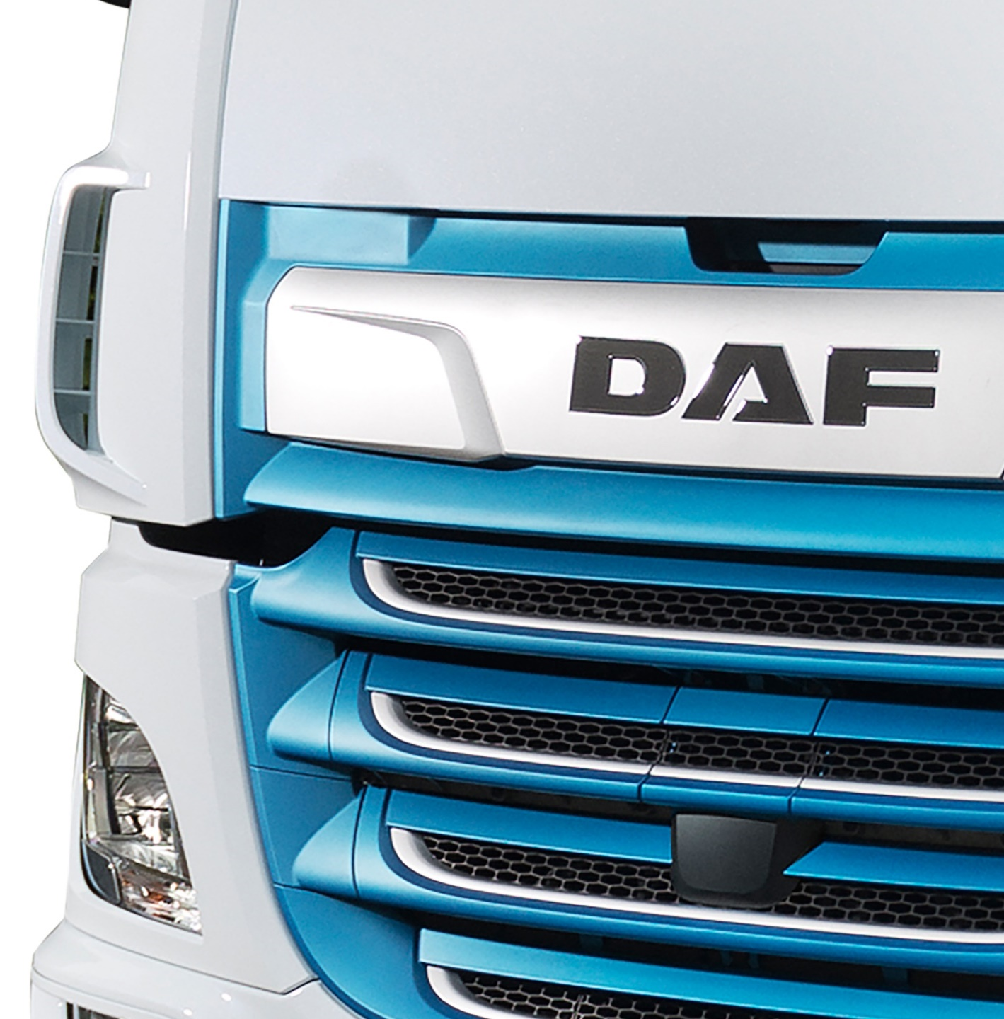
Any Questions?
Notes:
Thank you for your attention so far, can I take any questions.....

