Slide 1
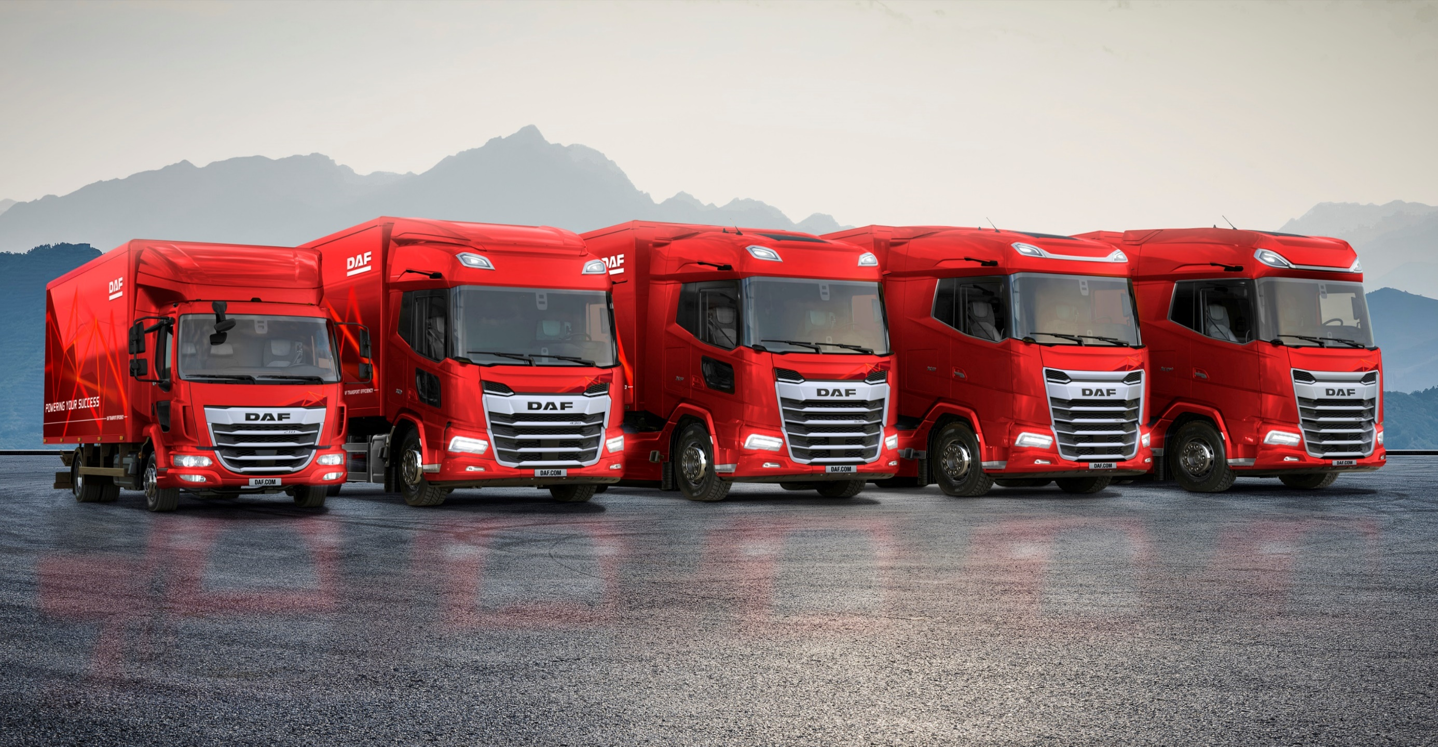
Welcome

Slide 2
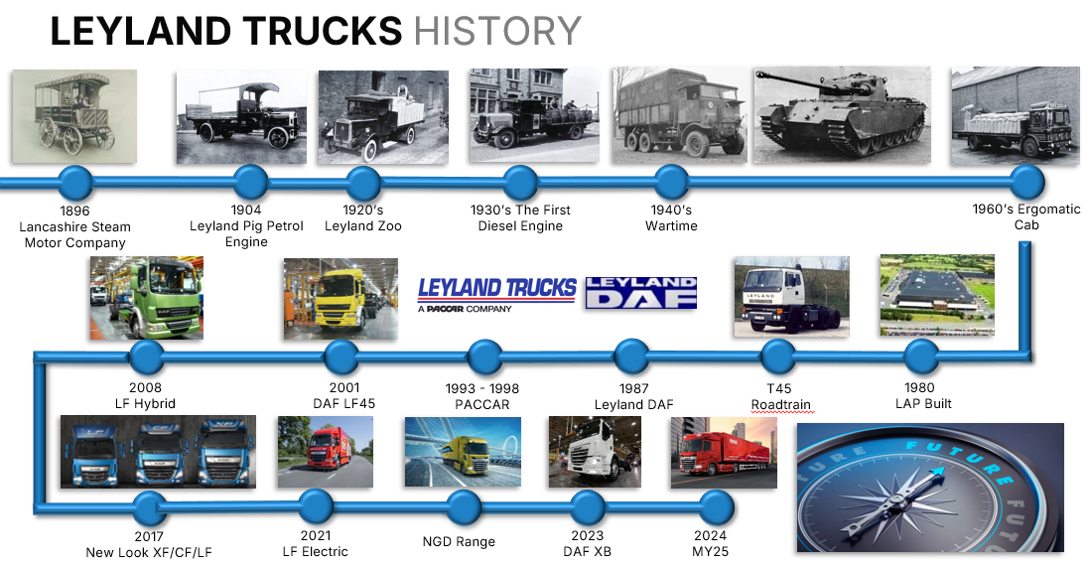
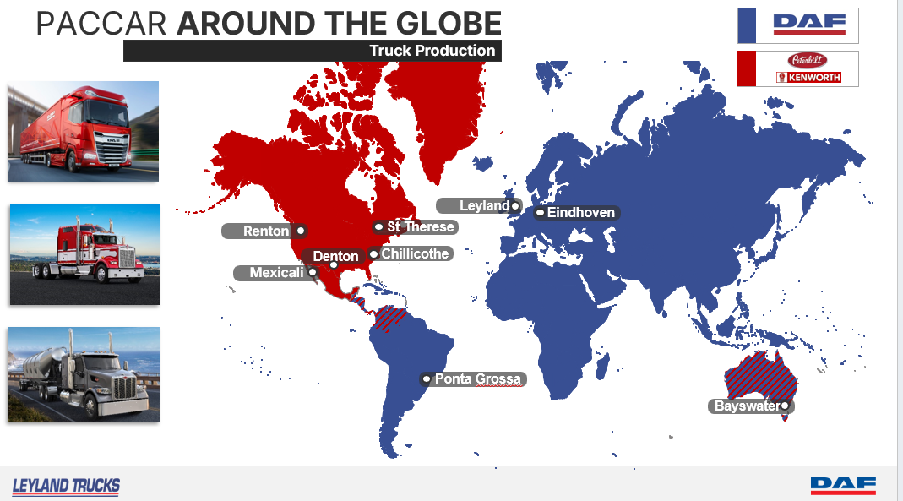
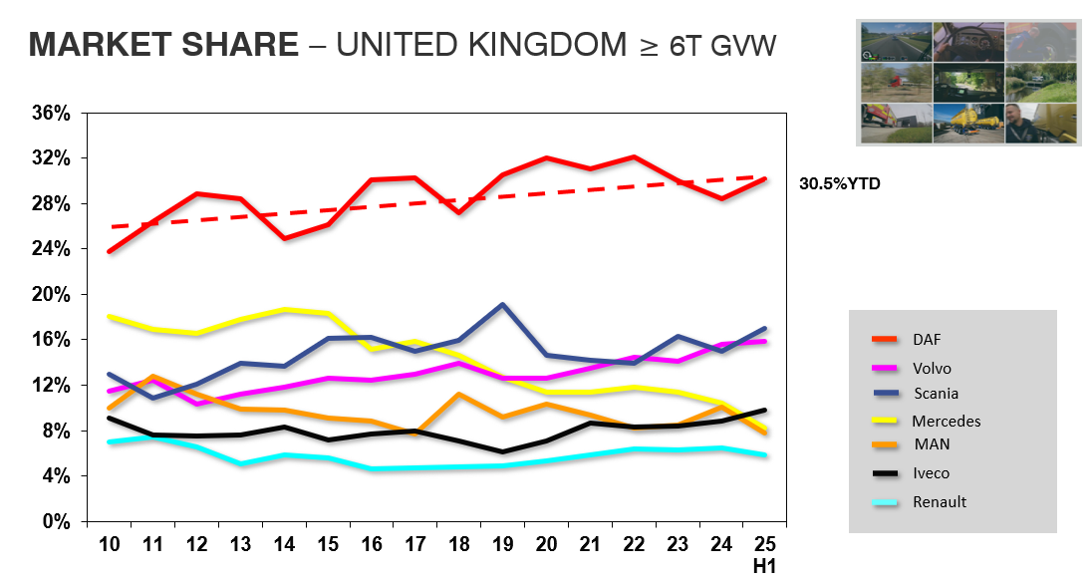
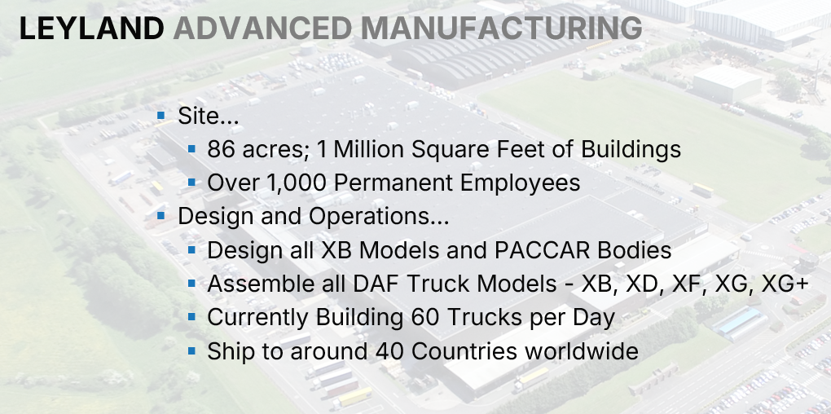

28%
Notes:
Leyland Trucks has been building trucks in Leyland since 1896. We have many generations of truck builders at this plant that provides us with a community of truck expertise.
Leyland and DAF entered common ownership once again when PACCAR bought both companies in 1996 and 1998.
Leyland is owned by PACCAR who has its headquarters in Seattle on the West coast of the USA, and is one of the largest producers of heavy and medium trucks in the world. Produce Peterbilt, Kenworth and DAF brand of trucks at sites all across the globe. DAF trucks have their headquarters and main assembly plant in Eindhoven, supported by the production facility here at Leyland in the UK.
We have been the UK Market Leader for 30 years, having 30% of the market against our competitors.
Over 1000 staff inc approximately 110 engineers
Leyland is the centre of light/medium duty truck expertise for PACCAR, and is responsible for the design of the XB range. On our assembly line we produce the full range of DAF vehicles and deliver trucks to 325 DAF dealers worldwide. Current production is 60/day, meaning every 7.5 minutes a truck comes off the production line.

Slide 3
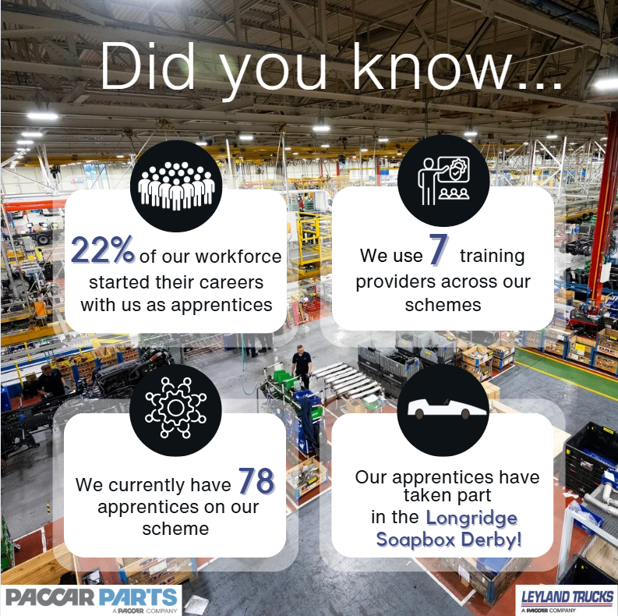

Slide 4





Our Apprenticeship Scheme
Variety of approved Government Apprenticeship Schemes
Preston’s College, ULan, Runshaw, Blackpool College, Training 2000 & Leeds Trinity University,
Regular communication with the college
Structured workplace rotations to ensure a wide-breadth of experience
Notes:
Follow Government approved Apprenticeship standards which mean that, not only do you complete a formal qualification, but you also have proof of your ability to do the job.
We use Preston’s College for the majority of our apprenticeships and for those that progress onto degrees we use UCLan. Training 2000, Runshaw and Leeds Trinity are also now being used as the scheme extends.
Attendance at the college varies depending on the apprenticeship that you are on.
We work very closely with the training providers to ensure that the scheme meets the needs of both the apprentice and the business and have the ability to tailor courses to our needs.
Some follow a very formal workplace rotation, whereas others are moved around at appropriate times, but the aim is that you all get to experience as much of the business as possible applicable to your role.

Slide 5
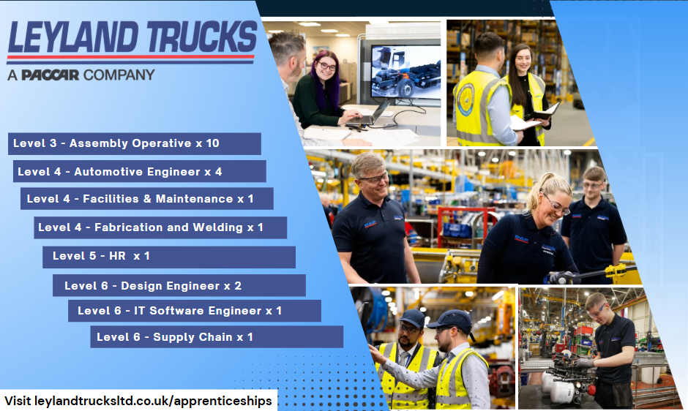
Notes:
Our 2026 Apprenticeship positions will open in January and we are recruiting for 21 apprenticeships in total.

Slide 6
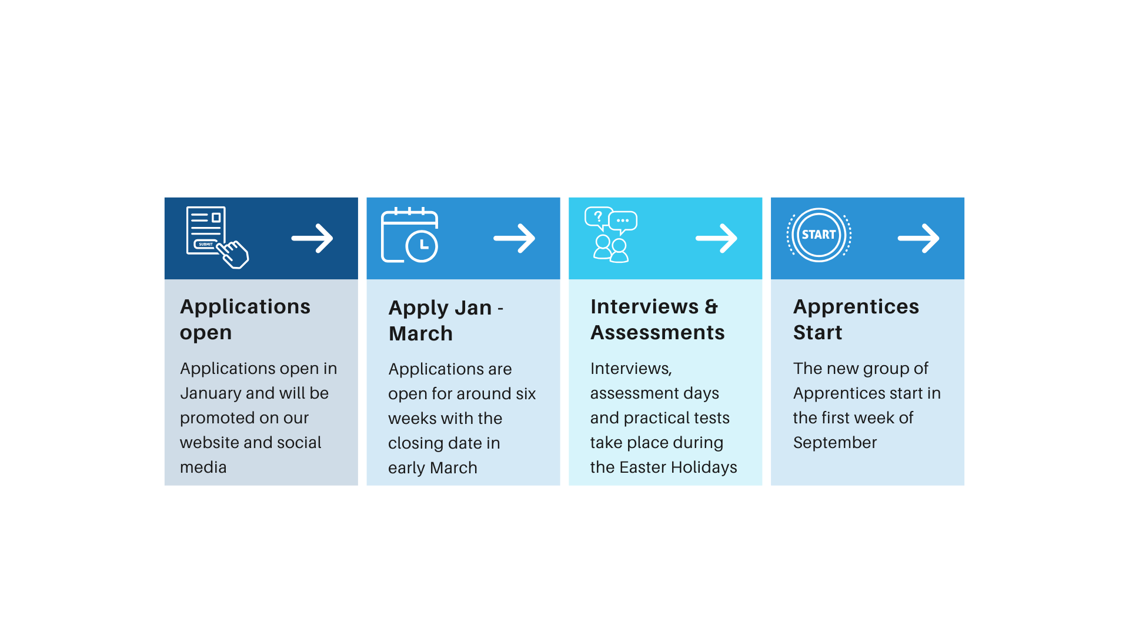
Intake Process

Slide 7
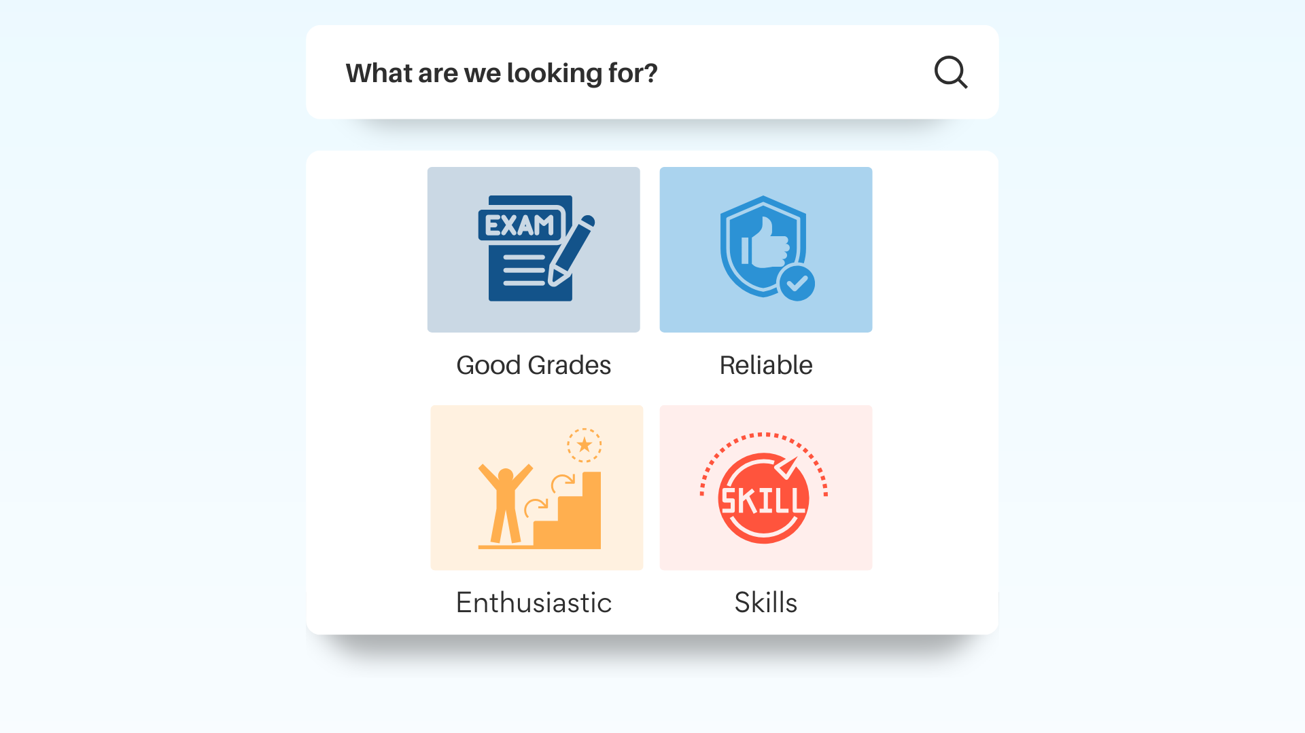
Notes:
Good Grades (5 GCSE at grades 9-4 incl Eng & Maths. Plus Level 3 qual where applicable)
Reliable (prefect/team captain/responsibility)
Enthusiastic (wants to work in their chosen field)
Skills (evidence transferrable skills/hobbies etc)
Give detail and bring Examples! ☺

Slide 8
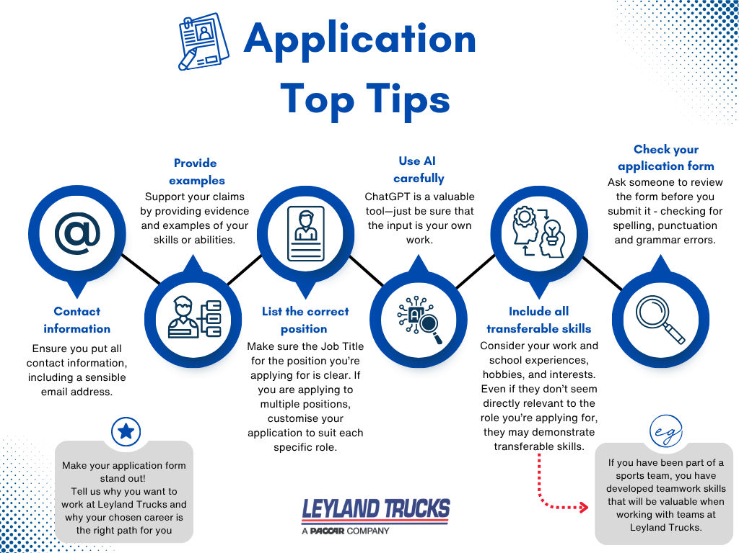

Slide 9
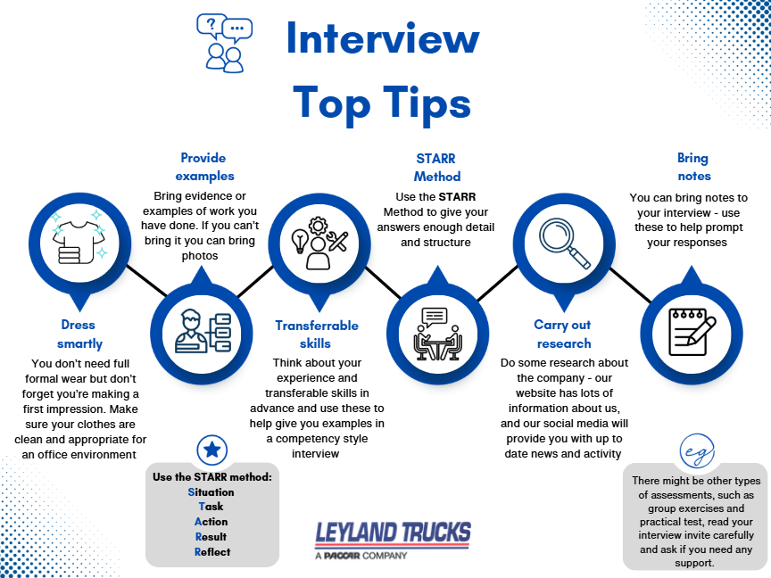

Slide 10


What happens after the apprenticeship?
Notes:
Aim is to secure a permanent position within the company
Track record of placing successfully completed apprentices
Continue development and growth within the business
Ex-apprentices are throughout our business and at all levels
Starting salary between 17 – 18k, qualified salary between 35 – 40k

Slide 11
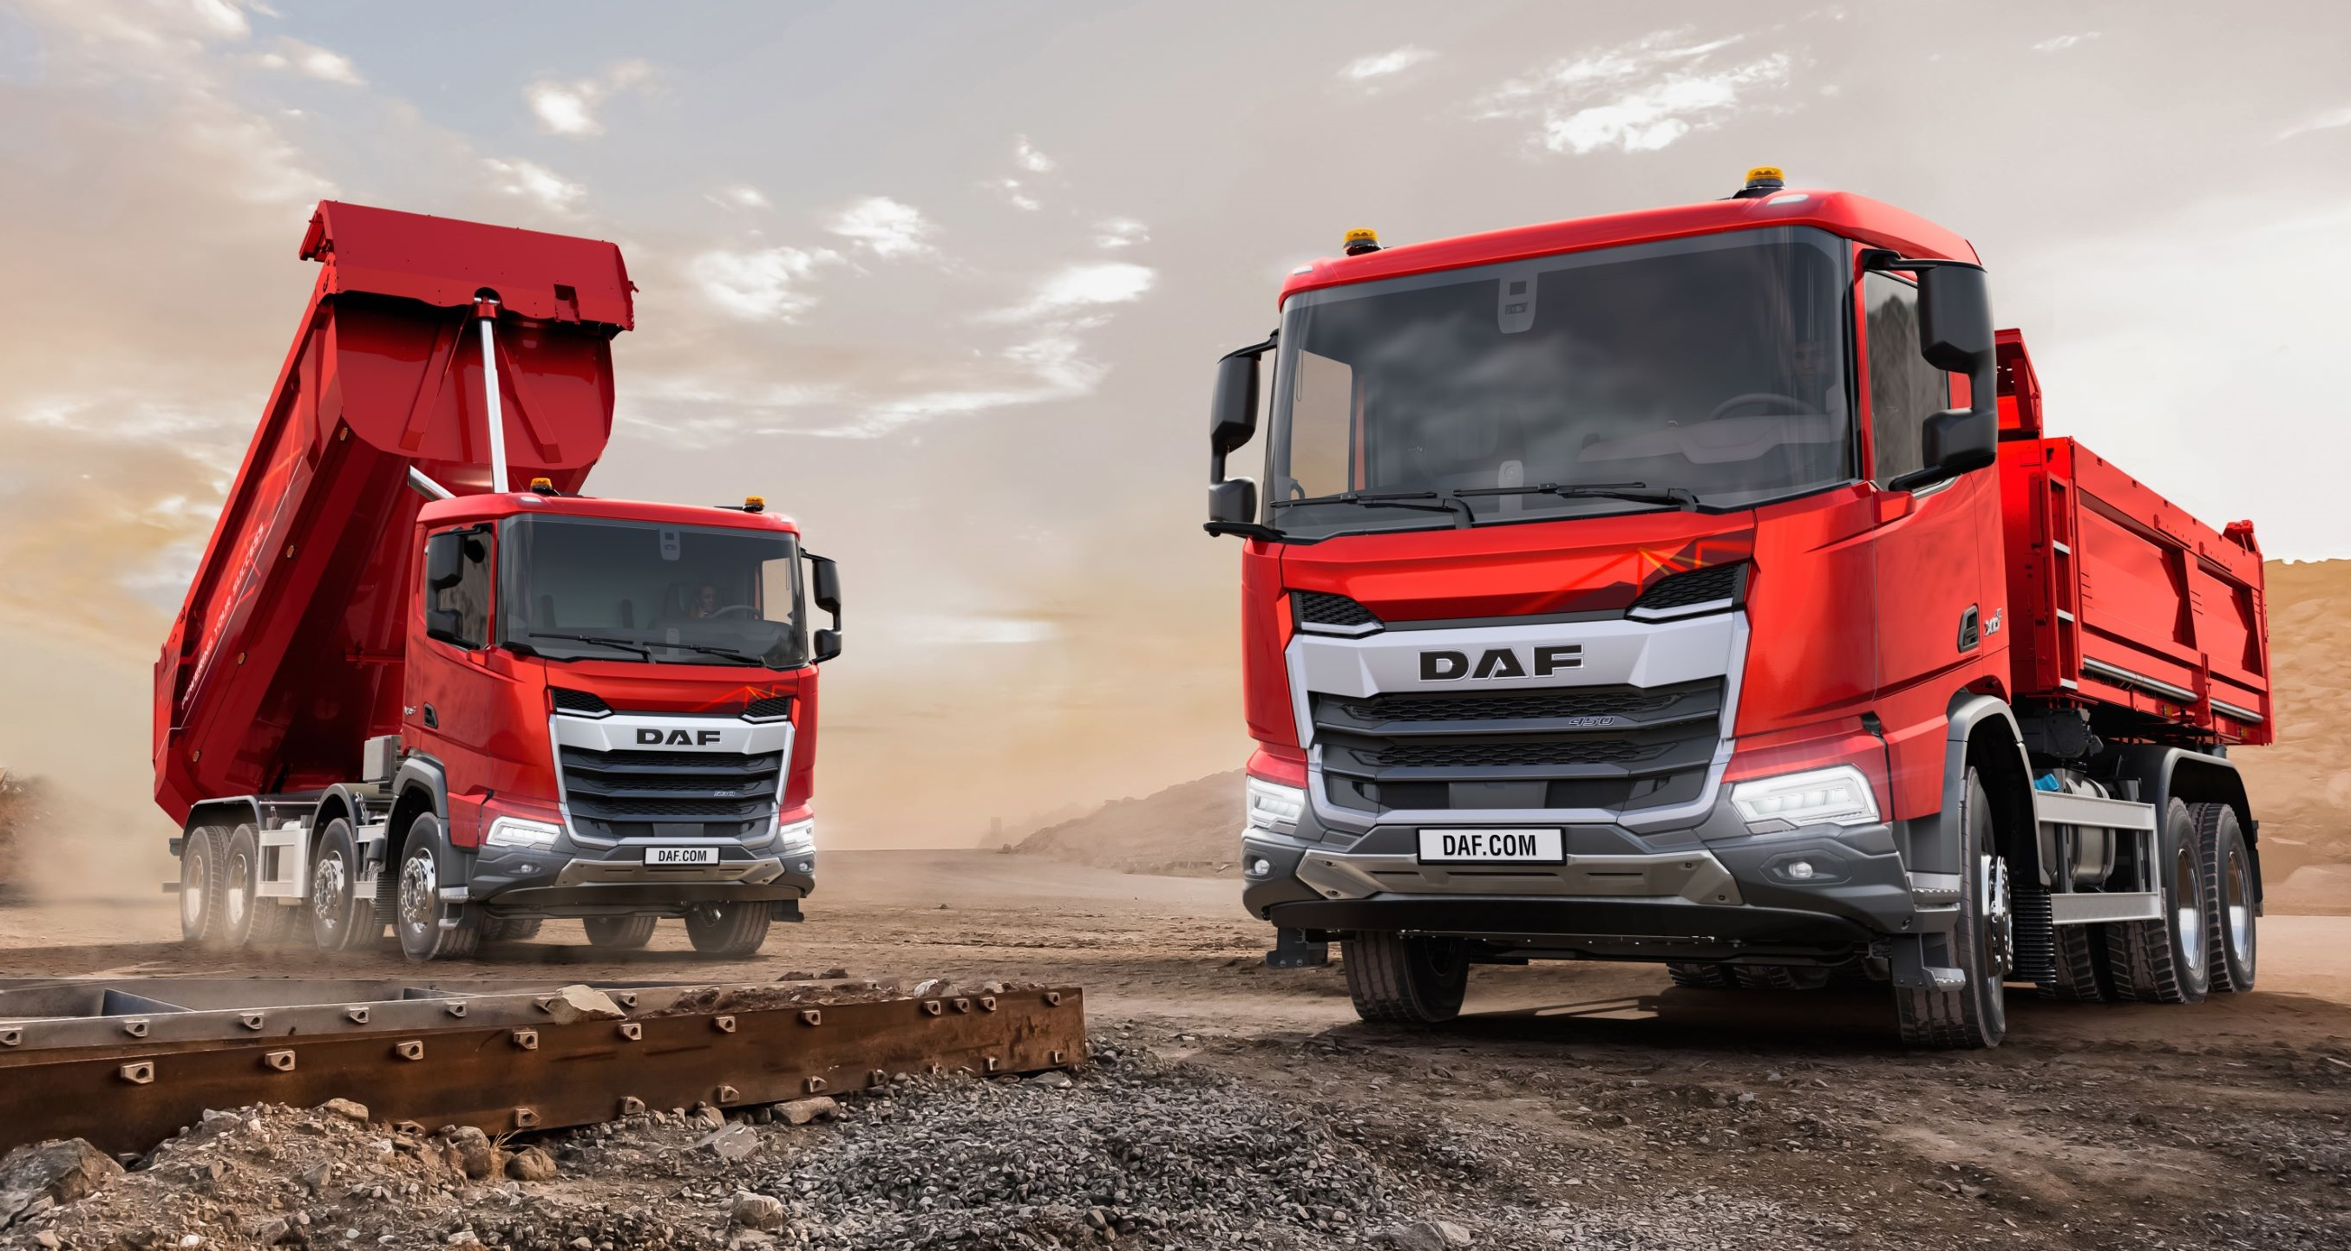
Any Questions?

